Slide 1


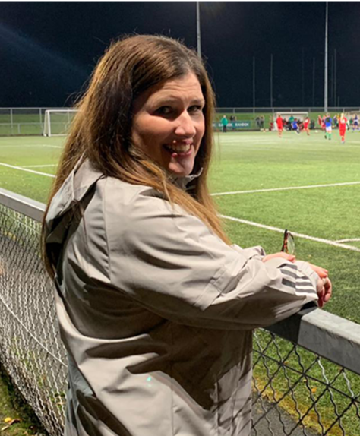
TRACEY ROBINSON
NATIONAL DIRECTOR , SPORTS CHAPLAINCY IRELAND
Northern Ireland Senior Womens Northern Ireland U17 & U19 Girls
Football Chaplain
Cliftonville FC Womens Co-chaplain

Slide 2
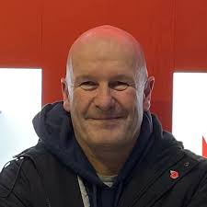
PHILIP MITCHELL
SPORTS CHAPLAINCY IRELAND
UK & IRELAND LIAISON
CHAPLAIN TO :
IFA DISABILITY LEAGUE,
IFA POWER WHEELCHAIR TEAM ,
IFA COACH ED DEPT ,
PFA NI
GLASGOW RANGERS ACADEMIES
ORANGEFIELD FC
ARDS FC FIRST TEAM (SUPPORT)
FAI U19 CO-CHAPLAIN

Slide 3
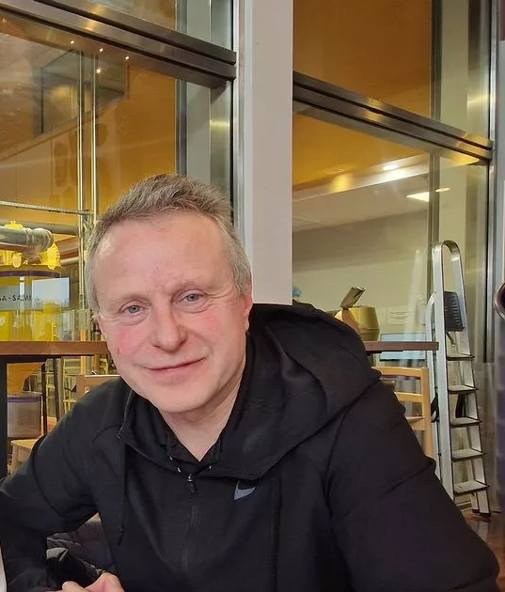
LIAM MCGRATH
COORDINATOR FOR FOOTBALL IN THE LEAGUE OF IRELAND / FAI
REGIONAL COORDINATOR FOR SPORTS CHAPLAINCY IN THE EAST AND MID EAST OF IRELAND
CHAPLAIN TO DROGHEDA UNITED FOOTBALL CLUB

Slide 4
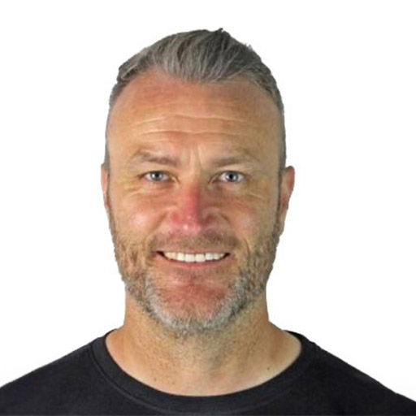
RUSSELL
BOWERS
Sports Chaplaincy Regional Support Manager
Support Chaplain to the IFA JD Residential Academy

Slide 5
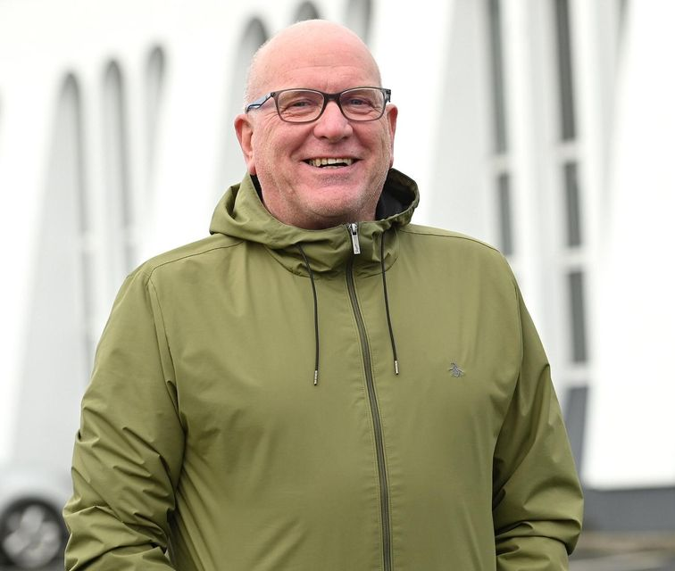
LESLIE ADDIS
SPORTS CHAPLAINCY MENTOR
CLIFTONVILLE FC LADIES CHAPLAIN
LARNE FC FIRST TEAM CHAPLAIN
PFA CHAPLAIN

Slide 6
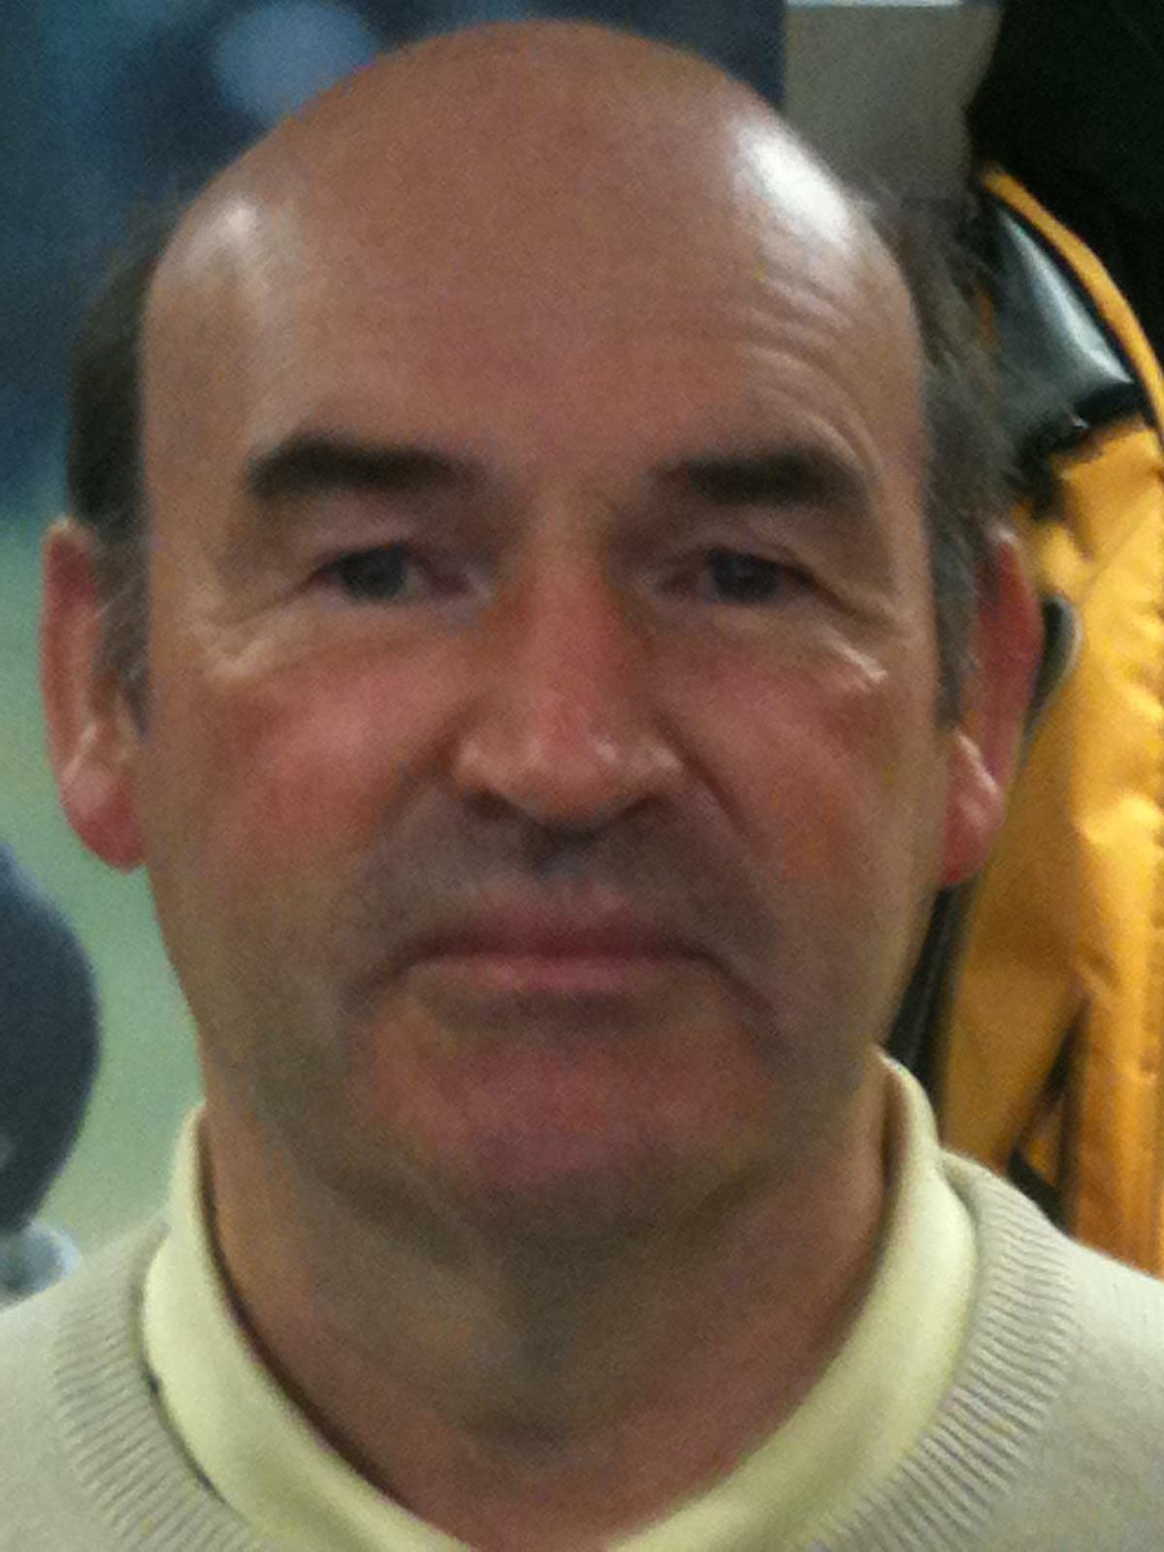
KEN
REVIE
SCI COORDINATOR FOR GOLF CLUB CHAPLAINCY
CHAPLAIN TO THE PGA GOLF CLUB PROFESSIONALS OF NORTHERN IRELAND

Slide 7
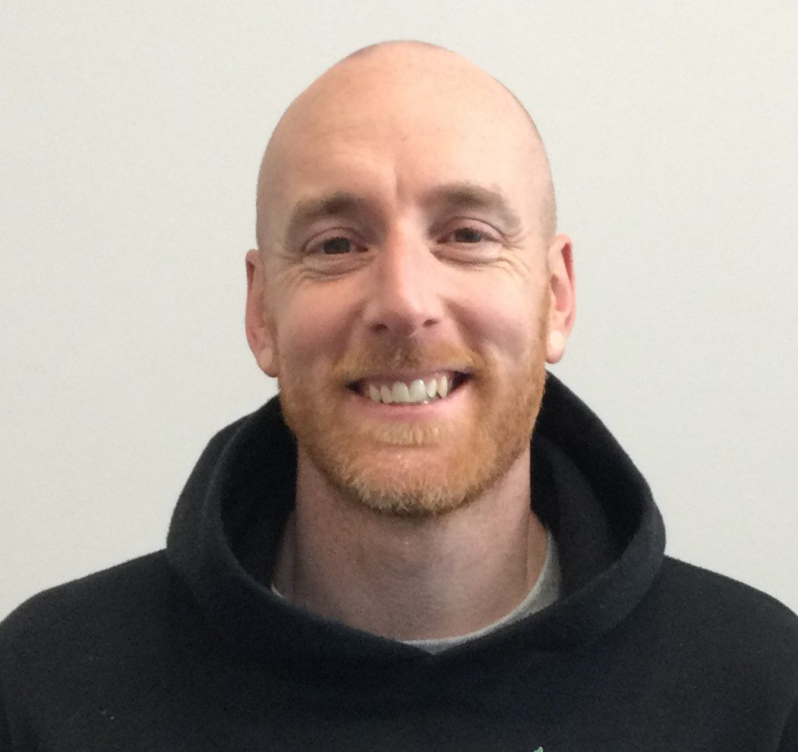
ALAN
DUDDY
SC IRELAND CRICKET COORDINATOR
CHAPLAIN TO THE
NORTHWEST WARRIORS
CHAPLAIN TO NEWBUILDINGS CRICKET CLUB & FOOTBALL CLUB

Slide 8
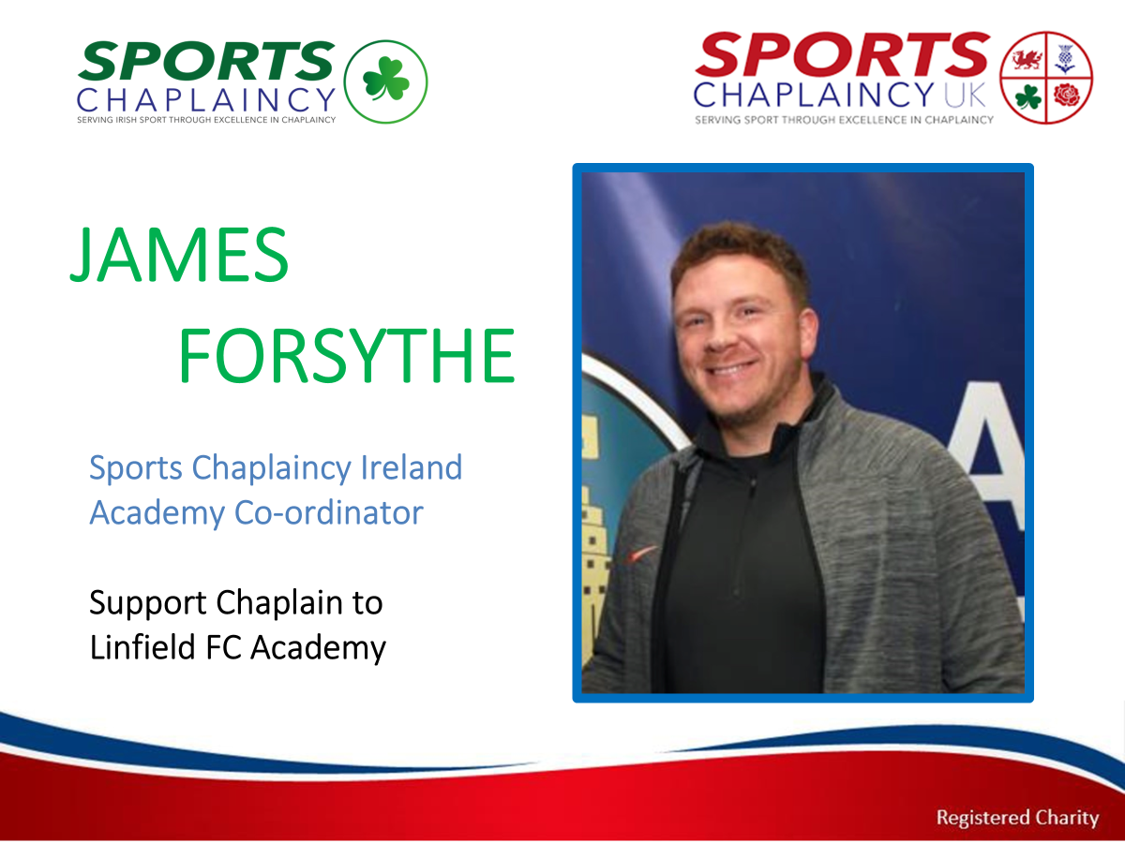

Slide 9
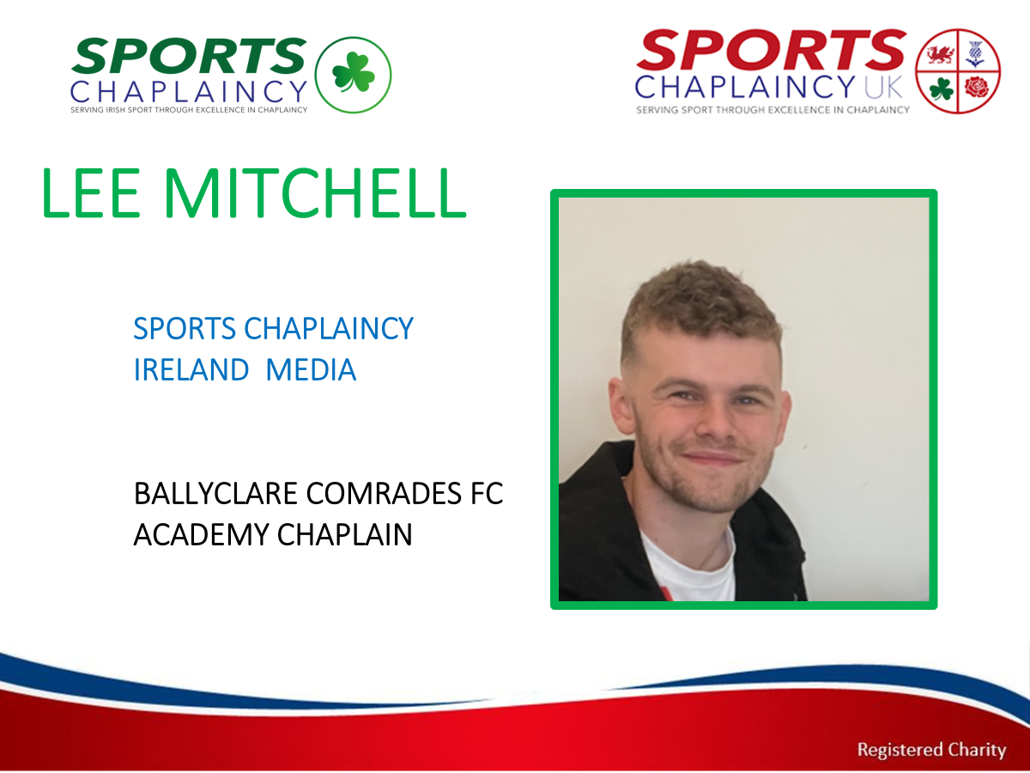

Slide 10
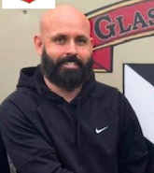
MARK
MULLIGAN
SPORTS CHAPLAINCY COORDINATOR FOR NORTH MIDLANDS
SPORTS CHAPLAIINCY COORDINATOR FOR AMATEUR FOOTBALL IN THE REPUBLIC OF IRELAND
GLASLOUGH VILLA FC CHAPLAIN

Slide 11
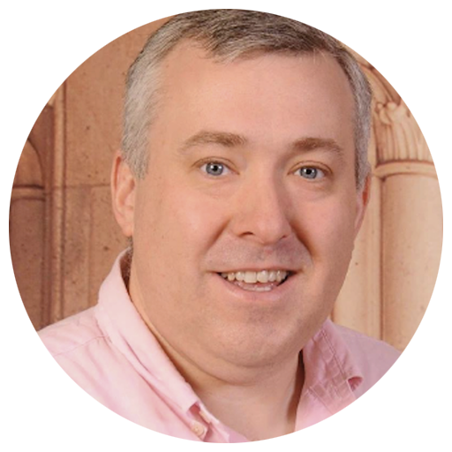
DANIEL
CALDWELL
SCUK & IRELAND TRUSTEE
COORDINATOR FOR SPORTS CHAPLAINCY IN WEST OF IRELAND
CHAPLAIN TO ATU LADIES GAA TEAM

