Slide 1
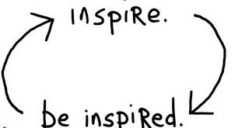
Inspired The Mentality of those involved in Sport
Sports Chaplaincy UK Conference 2016.
SCUK
Tuesday 6th October 2015
Dr Allan Johnston
MBBS, MRCPsych, Cert.Med.Ed(IU)

Slide 2
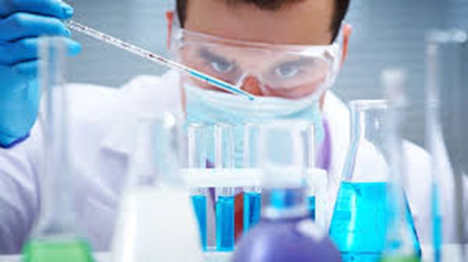
Who am I?
Thanks to Warren
Consultant CRHT Psychiatrist with the NHS at Derbyshire NHS FT
Chair of Derbyshire Suicide Prevention Strategy Group
Sports Psychiatrist formerly with Bradford Bulls RLFC.
Worlds First Rugby League Psychiatrist.
Trustee of State of Mind Sports Charity – A Rugby League Mental Health Charity
Speak widely for Pharmaceutical Co. about Building Winning Team Culture.
Allan.Johnston@nhs.net
@DrAllanJohnston
@Derbyshcft
@SoMRugbyLeague

Slide 3
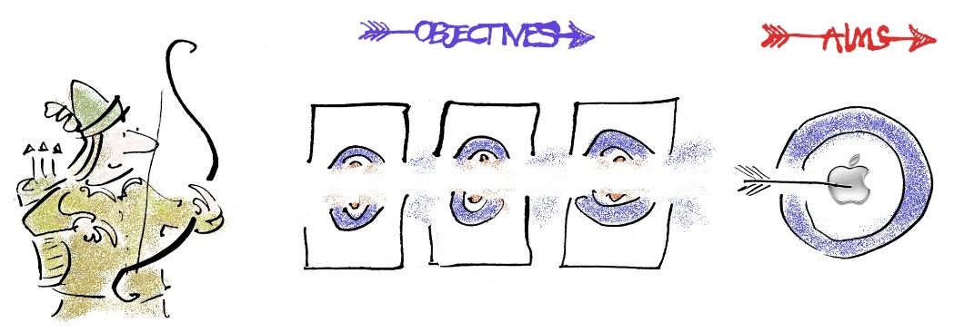
Aims & Objectives
To define ‘Mentality’ and its use across Sports.
Consider why Mentality is important for our roles within teams.
Discuss some examples of sports teams who have considered the Mentality of their athletes and ways to develop Team Culture.
Explore the complexities of Personality and how this relates to Mentality and Team Culture
Discuss my experience of Sports Psychiatry at the Bradford Bulls RLFC alongside Warren Evans, our Chaplain at that time.
Consider the role Chaplains can play in particular with Building Team Resilience, Role Modelling Team Culture and Creating Networks of Support
Time for Questions at the end, Lunch at 1315, OK?

Slide 4
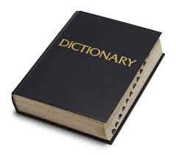
Definitions
Mentality - The Characteristic Way of thinking of a person or Group.
Sport - A game involving physical exertion and skill in which an individual or team competes against another for entertainment. “Just a Game?”
Those involved - Such a wide variety of people from the athletes to the ground staff, to the CEO. Will be a challenge to define “the mentality.”
Chaplaincy - A sports chaplain provides care for the sports person and the broader sports community including the coach, management and their families. They not only provide spiritual support and guidance to a player, but also have the ability to empathise and relate to some of the challenges facing the participant.
My Pre Match Nerves and Your Enormous Experience in this field

Slide 5
Mentality and Sport - Circa 1895

Slide 6
Why is Mentality important?
The most successful Team…of all time…in any field?

Slide 7
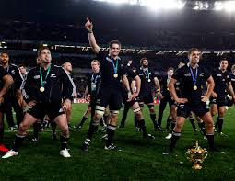
The most successful Team of all time….
The New Zealand All Blacks Rugby Union team.
In over 100 yrs the All Blacks hold an 84% winning record against all opposition
They hold a winning record against EVERY TEST NATION IN THE WORLD (including the British & Irish Lions, and the World XV).
World Rugby Heavyweights Ireland, Scotland, Italy, Argentina, Samoa, and Fiji, Romania (the best team in Eastern Europe), Canada (the best team in North America), Japan (the best in Asia) have NEVER… EVER beaten New Zealand in over a Century of competition.
They have scored more than twice the no. of points than all their opposition combined.
They have never been ranked lower than 3rd on the World Rankings in all history.
Brazilian Football, Australian cricket, Canadian hockey… don’t come close
This tiny island nation boasts a player pool of just 90,000.
How have they built this most consistent winning culture?

Slide 8
Perhaps…
The Tallest nation on earth…..? The Dutch mean young male height 6ft 4in
The Heaviest nation on earth…? Tonga 87% BMI >25
The Fittest nation on earth…? North Korea 4% BMI >25
The Biggest population…? China 1.4 Billion people (NZ 124th)
The Biggest Rugby playing pool? England 2.5M registered RU players
The Largest land mass…? Russia 12% of world landmass
The Sunniest climate…? Egypt >4000hrs sunshine / year.
The Haka? Fiji, Samoa, Tonga - Similar Traditional War Dance
I could go on…
On no measure does New Zealand have any right to have the best Team
So Why???

Slide 9
A Focus on their People

Slide 10
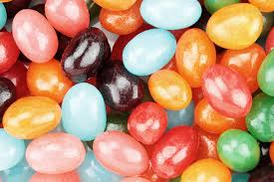
So who are your people?
All of humanity in its incredible & wondrous variety!
Think for a moment about the different people in your team…
The Owner / CEO
The Coach / Head of Performance
The Captain
The Medical Team – Physio, S&C, Psychiatrist/Psychologist?
Admin, Cleaner, Bar staff, Ground staff.
What are their similarities and differences?
How many ‘non typical’ mentalities are there - eg a Quiet Captain?
Is there a ‘typical’ CEO or a ‘typical’ Captain?

Slide 11
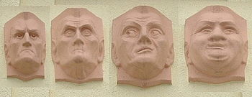
Personality Categories – Types & Traits
Personality – Characteristic Behaviour-Response patterns that each individual evolves, consciously and unconsciously, as his or her style.
Numerous different theories – Hippocrates, Freud, Jung, Beck, etc
Previously used distinct personality categories - Types
Eg ‘Type A’ = competitive/ambitious, Type B= relaxed/reflective
Now known to be more complex, more dimensional - Traits
Eg degree of Extraversion/introversion/agreeableness/neuroticism
Environmental Influences - personality traits are more malleable by environmental influences than researchers originally believed.

Slide 12
Myers-Briggs Personality Inventory – You on a good day -> Hands up

Slide 13
Myers-Briggs Personality Inventory – and You on a bad day -> Hands up…any changes?

Slide 14
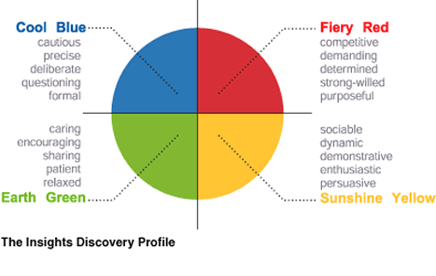
Myers-Briggs Personality Inventory → Exercise
Where would you place….
The Owner / CEO
The Coach / Head of Performance
The Captain
The Team Doctor
The Cleaner
The Head Ground staff
Where would you place Yourself?
How does this affect your Relationships?

Slide 15
Personality/Mentality – Take home messages
Personality is complex made up of a million genetic and environmental factors.
Multiple Genes code for Personality/ Mentality - Levels of aggression have been linked with 16 different gene sequences.
Environmental factors also crucial eg Childhood experience & Parenting.
Some of these Environmental factors are within your control – eg Team Culture
Consider your approach to a person of the opposite personality style
eg If you are Green how you deliver an important message to a Red head.
But its even more complex than this – Our Personality/Behaviour changes rapidly
With time, with stress, with different types of challenge, between individuals

Slide 16
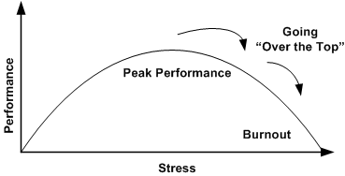
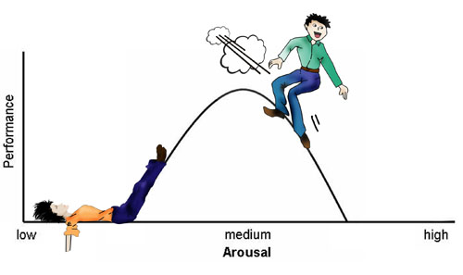
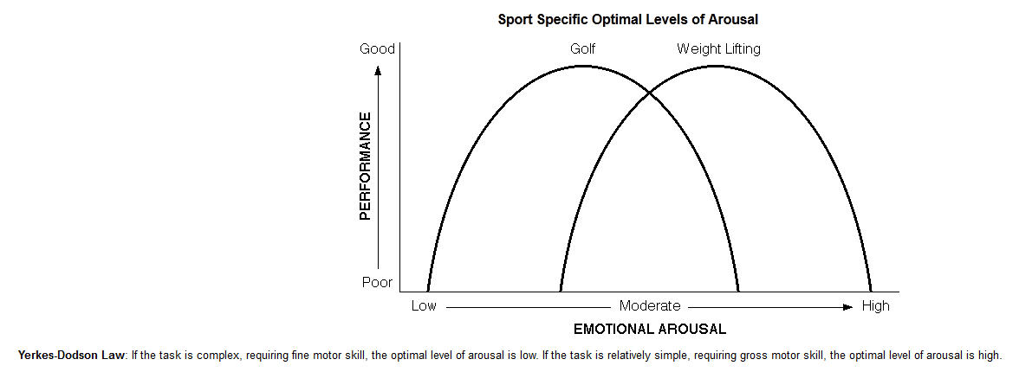
The Yerkes-Dodson curve
Stress
Individuals Different Challenges

Slide 17
Experience at the Bradford Bulls RLFC
Sports Psychiatrist at the Bulls 2012/13 and 2013/14 seasons
Hired by Francis Cummins – Wellbeing, Performance & Policy.
33 players - 3 had seen Psychiatrist /Psychologist before, 30 not.
Principles: Normalise, Integrate, Flexible, Proactive, Confidentiality.
Depression, Panic disorder, OCD, Addictions - Substances and Gambling, Hyperthyroidism, Anger/Impulsivity, Relationship stress, Sleep problems, etc.
94 of 95 appointments attended on time, 75% requested by the Player.
Financial difficulties – Administration x 3, New Owners, different approaches to running the club, selling my role, “but why do we need You And Warren!
Effects on coaching and medical staff, Players Wives, GF, Children, etc.
Team work, Me better understanding the role of the Chaplain
Working with Warren and a players wife with Postnatal Depression.

Slide 18
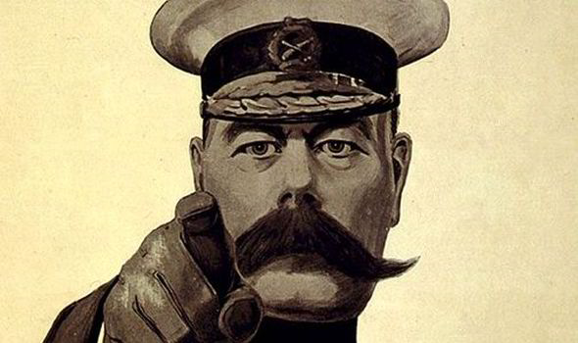
What You Can Add
Your Sports Team Needs You!
Work out your USP as the Team Chaplain
May I suggest some specialist skills which I feel you bring:
Listening, Understanding and Empathy
Consistently present but with a Flexibility of approach inc. Spirituality
Normalising mental distress, working to reduce stigma, eg LGBT
Building team Resilience especially Perceived Social Support
Role Modelling Team Culture
Creating Networks of Support

Slide 19
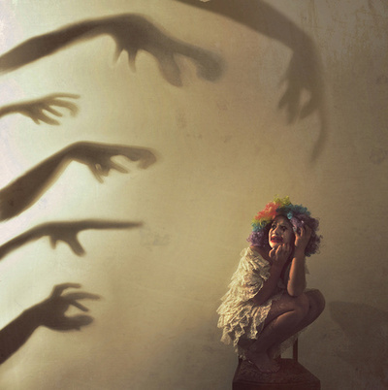
Vulnerability to Stress Zubin and Spring 1977
Stress = Perceived Demands > Perceived Resources
External causes – Increased Demands
Life events – Family bereavement, relationship split, financial difficulties, housing issues
Work stress / pressure – almost universal in Sports
Injury & Recovery
External causes – Reduced Resources
Mental illness
Addictions – Alcohol, Drugs, Gambling, etc
Isolation & Loneliness
Alexithymia – Not be able to understand or communicate own feelings AKA not talking about problems
Internal causes - Perception
Low self esteem, negative self image, self blame, Pessimism
Unrealistic self expectations, Perfectionism, Rigid thinking, lack of Flexibility, All-or-Nothing attitude
If we’re going to control the controllables – Need to change Perception…

Slide 20
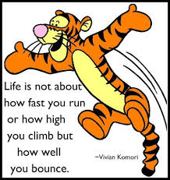
Chaplains: Building Resilience to Stress
Fletcher & Sarkar (2012) Study of Olympic Champions
Defines Resilience as 5 Key traits:
Positivity
Motivation
Self Confidence
Focus
Perceived Social Support
Most athletes have 4 of these…
You can help with the 5th.

Slide 21
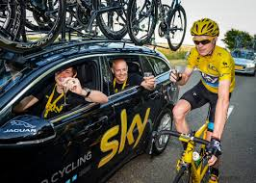
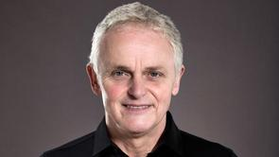
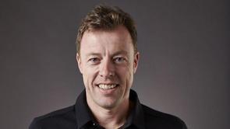
Chaplains: Role Modelling Team culture
Team Sky - Tour de France wins 2012 (Wiggins), 2013 (Froome), 2015 (Froome).
2014? “Total Failure” - Froome Crashes out Stage 5, No Sky rider in G.C. top 10.
“Ground Zero… Rip it up and start again” Dave Brailsford, Team Sky Manager.
Credits success in 2015 to changes in Team Culture – Simon Jones, Sky Performance Scientist
Winning Behaviours App – all team provide weekly self reports.
Join Team Sky Today! Score yourself 1-5 on each of these traits:
I don’t moan - I continuously look to learn
I am in control of my emotions - I actively listen
I don’t criticise the team - I proactively solve problems for my team-mates
I seek & give constructive feedback - I seek out marginal gains

Slide 22
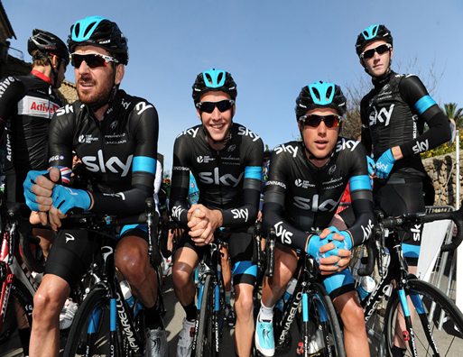
Exercise → Join Team Sky Today!
Score yourself 1-5 on each of these traits:
I don’t moan
I am in control of my emotions - I actively listen
I don’t criticise the team - I seek out marginal gains
I seek and give constructive feedback - I continuously look to learn
I proactively solve problems for my team-mates
Score ?/40
How can you improve?
How can you Role Model the Team Culture your athletes need?

Slide 23
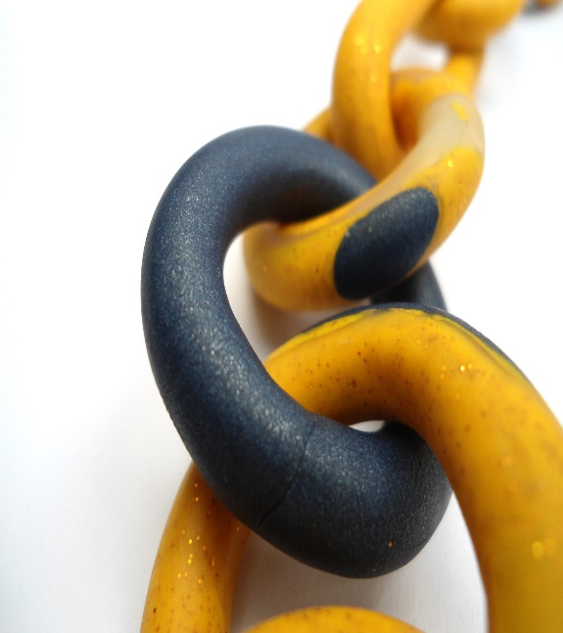
Chaplains : Creating Networks of Support
Make links with other Individuals and Organisations.
Use conferences like today to network and build contacts
Consider using Social Media to communicate your message widely
State of Mind “an exemplar organisation” (DOH Suicide Prevention Strategy 2014)
Develop Pathways of Care for Key Groups:
Eg Depressed player:
Teammates'-Chaplain-Team Psychiatrist-GP
Eg Injured player
Team Doctor-Surgeon-Physio-S&C-Psychiatrist-Chaplain

Slide 24
Self Support for Chaplains
Chaplain Heal Thyself (Not).
Support Networks – Who You Gonna Call?
Peer groups
Build Personal Resilience
Manage your own Stress levels, Resilience & Coping Strategies
Remember Vulnerability slide – Unrealistic Self Expectations, no one expects you to be Superman/Wonder Woman even if you do yourself

Slide 25
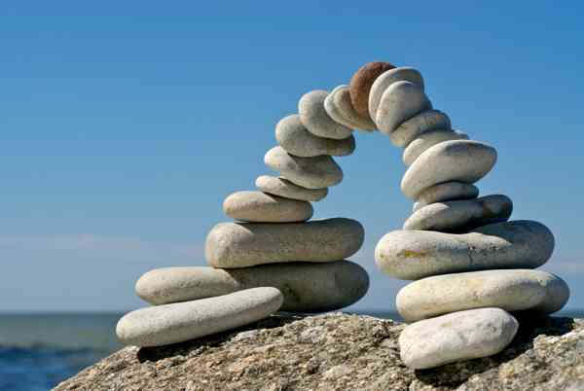
Summary & Conclusions
People are Complex, so Mentality is Complex
Genetic and Environmental factors involved Personality and Mentality
Fluid and changeable dependent on Stress, Environment and Culture
Which You can shape!
By Role Modelling - Setting a Benchmark for Team Culture standards.
By Building Team Resilience - Increasing Perceived Social Support
By creating Networks of Support
And by Supporting Yourself

Slide 26
Thank you

